Slide 1
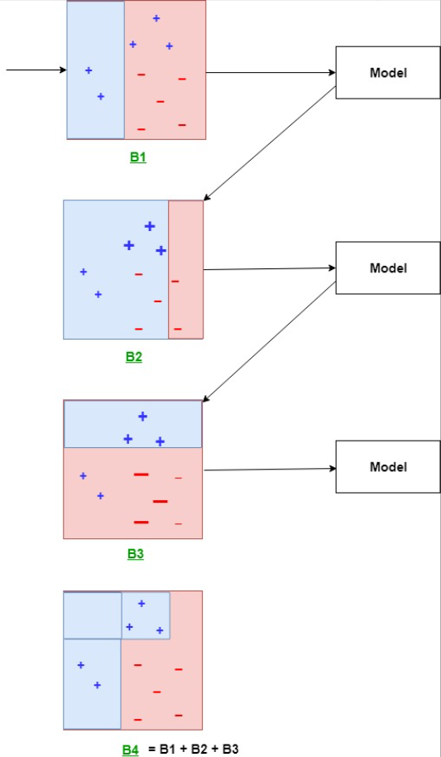
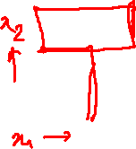
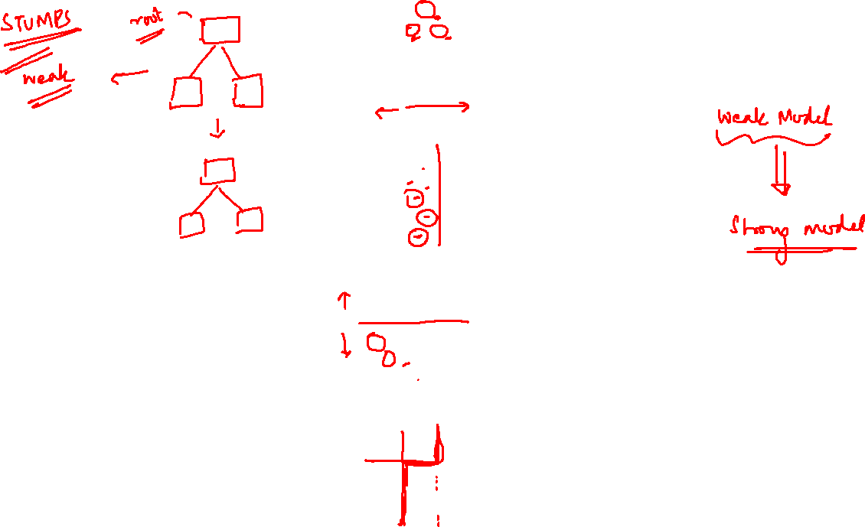
ADABOOST

Slide 2
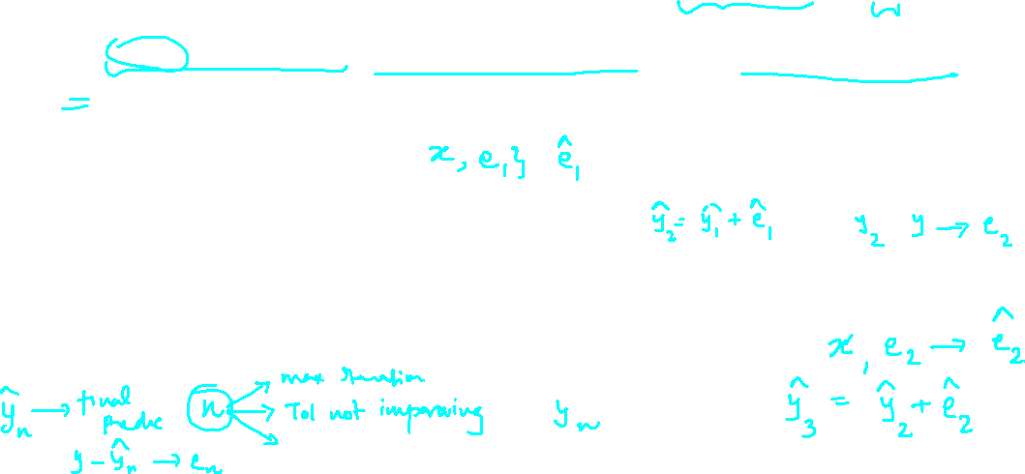
Steps in Gradient Boost Flow:
Fit a simple decision tree or Linear regression [call x as input and y as output]
Calculate error or residuals = Actual target value, minus predicted target value [e1= y - y_predicted1 ]
Fit a new model with error residuals as target variable with same input variables [call it e1_predicted]
Add the predicted residuals to the previous predictions [y_predicted2 = y_predicted1 + e1_predicted]
Fit another model on residuals that is still left. i.e. [e2 = y - y_predicted2] and repeat steps 2 to 5 until the sum of residuals doesn’t decrease anymore or max iterations specified is reached.
Same logic is applicable for a classification problem also. Only the method of calculation of error/residuals if different.

Slide 3
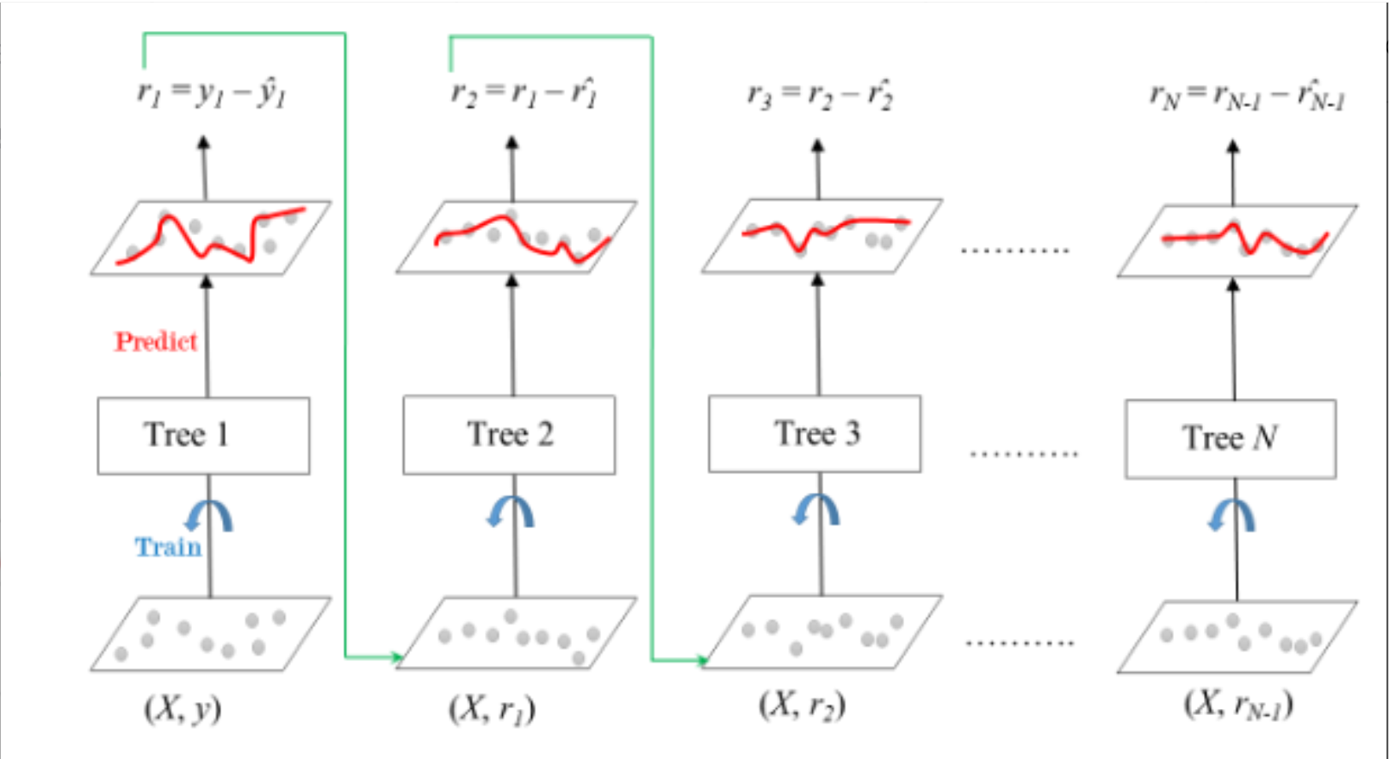
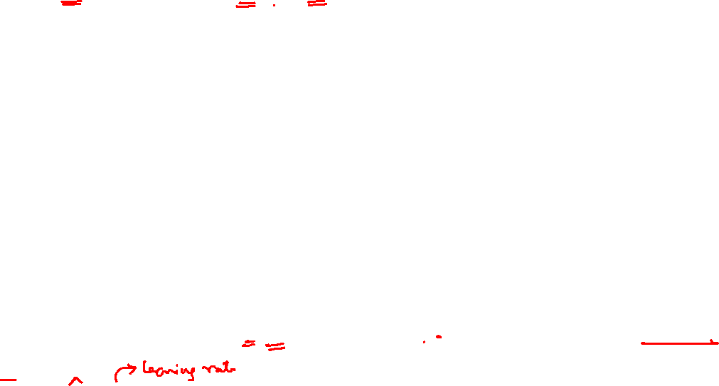
y(pred) = y1 + (eta * r1) + (eta * r2) + ....... + (eta * rN)
y(pred) = y1 + (eta * r1) + (eta * r2) + ....... + (eta * rN)

Slide 4
